Slide 1

Daily Activities & Personal Finance Tracker
Presented by:
Jenish Limbu
Kiran Jethara
Students of:
Padmashree International College
Tinkune, Kathmandu
Bca 4th semester

Slide 2
Introduction
Daily Activities and personal Finance Tracker.
It Helps to Track Daily Tasks.
It Helps to Track Personal Finances.

Slide 3
Problem Statement
Unmanaged Tasks
There are a lot of problems while managing all the daily and occasional tasks.
Unplanned/Unmanaged Personal Finances
While spending or managing money, many people don’t realize their overspending in certain occasional outflows.

Slide 4
Objective
The objectives of “Daily Activities & Personal Finance Tracker” are: ➢ To provide users with a comprehensive view and tracking system for their daily activities and personal finance-related data. ➢ To help users in maintaining disciplined habits.

Slide 5
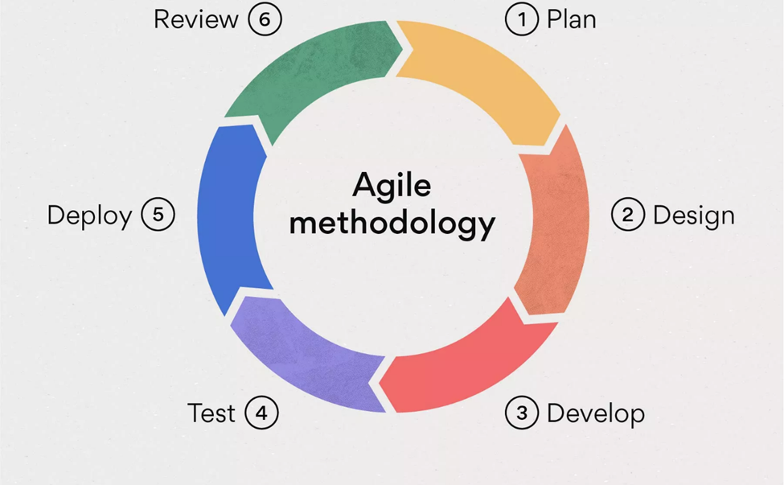
Development Methodology

Slide 6
Requirement Analysis
Functional Requirement
Non-Functional Requirement

Slide 7
Functional Requirement
1. Multi-user.
2. Tasks Summary/Conclusion.
3. Income/Expenses comparison.
4. Budget Allocation For Expenses.

Slide 8
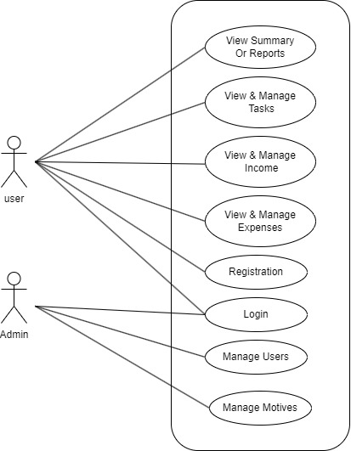
Use Case Diagram

Slide 9
Non-Functional Requirements
Availability
Flexibility
Security
Reliability
Easy To Use

Slide 10
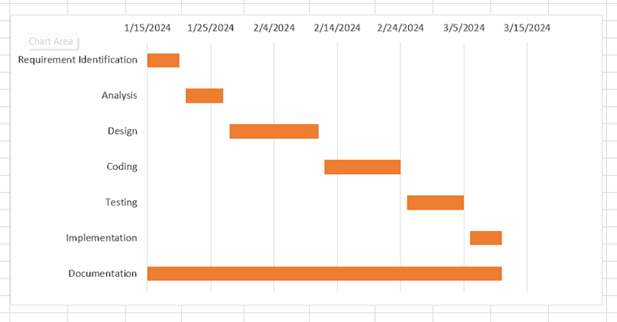
Gantt Chart

Slide 11
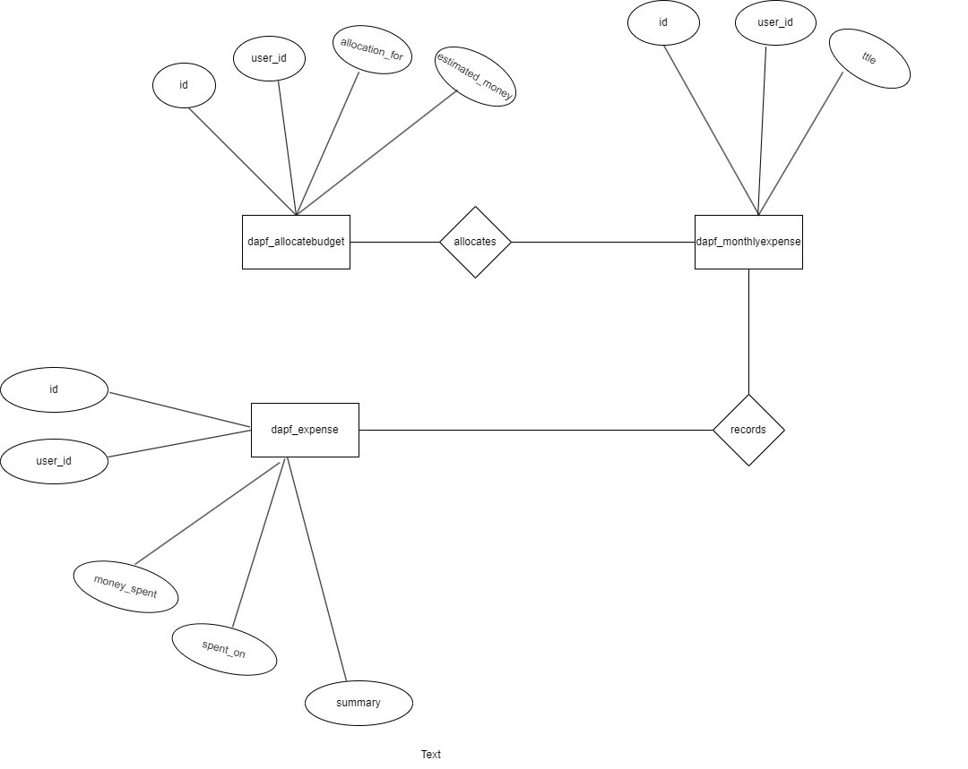
ER-Diagram Er Diagram for Expenses

Slide 12
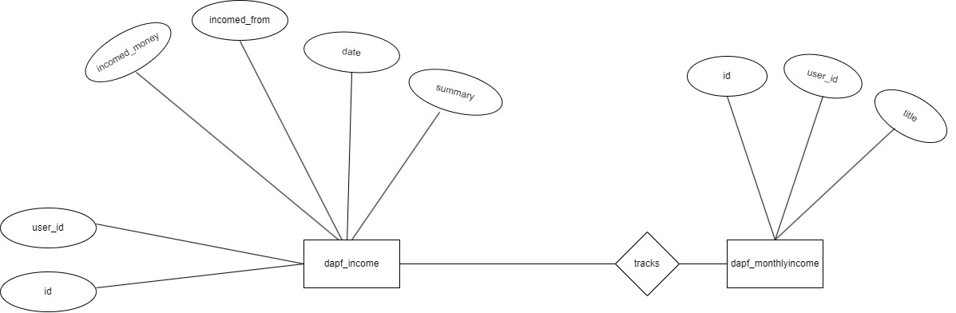
ER-Diagram Er Diagram for Incomes

Slide 13
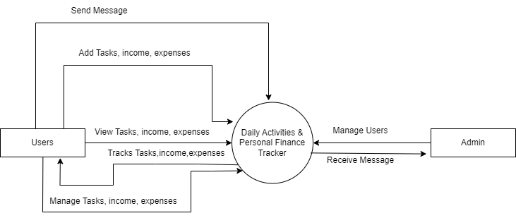
DFD Level 0 DFD

Slide 14
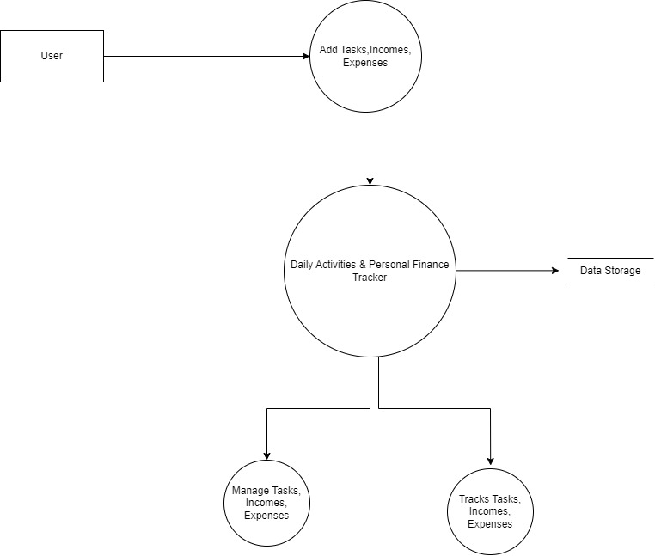
DFD Figure: Level 1 DFD

Slide 15
Implementation Tools
1. Front-End Tools
I . HTML
II . CSS
III . JavaScript
2. Back-End Tools
I . Php
3. Database
I . MySQL
4. Documentation Tools
I . MS PowerPoint
II . MS Word
III . Draw.io

Slide 16
Challenges Faced
XAMPP Server Crash.
Limited Similar Systems for Research.
Frequently Changing Ideas.
Improper Planning For Databases.

Slide 17
Conclusion
In conclusion, the "Daily Activities & Personal Finance Tracker" system is a comprehensive tool designed to empower individuals by providing insights into their daily routines and financial habits. By facilitating the recording and analysis of time and money management, this system aims to help users make informed decisions, optimize their tasks, and enhance their overall well-being.

Slide 18
Thank You

